Slide 1

EMAIL SPAM DETECTION
La Tosa Giuseppe Pio
09/01/2025

Slide 2

GOAL DEFINITION
Email spam refers to unsolicited and unwanted messages, often sent in bulk, that may contain advertising, phishing attempts, or malicious content.
My goal is to build a model for spam mail detection in order to classify emails as either spam or not spam based on their content and characteristics.

Slide 3
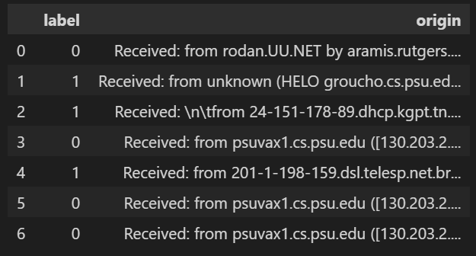
DATA ACQUISITION
Dataset
TREC 2006 sourced from the '2006 TREC Public Spam Corpora’
Attributes
label: Int type, 1 for spam and 0 for ham
origin: String type, original raw email

Slide 4

DATA EXPLORATION
Found 37822 email of which: 24802 spam (65.9 %) 12910 ham (34.1 %)
Found 33 duplicates
Found 0 missing values

Slide 5
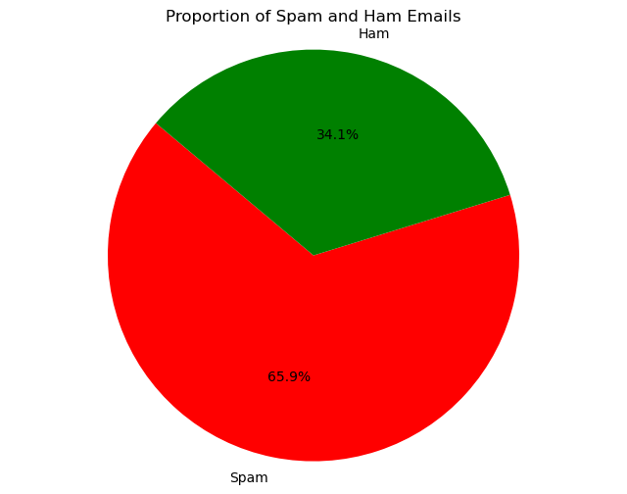
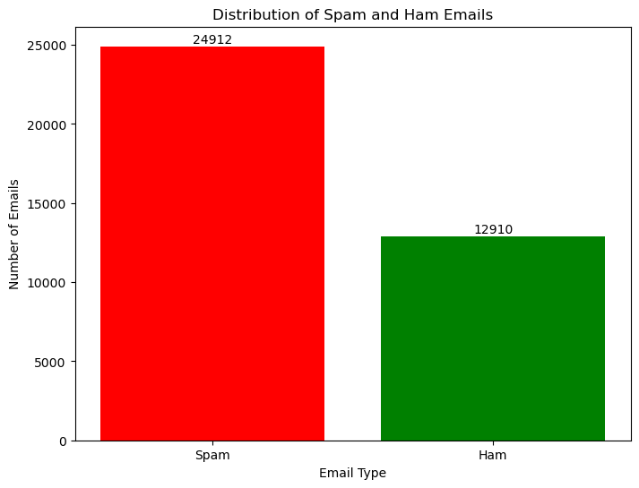
DATA VISUALIZATION PRE-PROCESSING
Notes:
Here, I plotted a bar chart and a pie chart to visualize the distribution of spam (Spam) and non-spam (Ham) emails in the dataset.
I used different colors for clarity: red for spam and green for ham. Additionally, I added exact counts on top of each bar to provide clear numerical context.

Slide 6

DATA CLEANING
The attribute origin was renamed to emails for improved clarity and a new attribute, label_text, was created by mapping numeric labels: 0 to 'Ham' and 1 to 'Spam'.
Converted email strings into email objects to facilitate parsing and extraction of the main body content.
Further cleaned the email body by removing punctuation, collapsing extra whitespace, and converting all text to lowercase
Added a new attribute, text, that stores the cleaned email text.
Notes:
The attribute origin was renamed to emails for improved clarity and a new attribute, label_text, was created by mapping numeric labels: 0 to 'Ham' and 1 to 'Spam’. This makes the data easier to interpret, as the text labels clearly indicate whether an email is spam or not. Converted email strings into email objects to facilitate parsing and extraction of the main body content. If the email has multiple parts, it ensures the text part is extracted.
Removed HTML tags, scripts, styles, and other non-content elements from the email body.
Further cleaned the email body by removing punctuation, collapsing extra whitespace, and converting all text to lowercase.
Finally, I Added a new attribute, text, that stores the cleaned email text.

Slide 7

DATA PREPROCESSING
Tokenization
Stop Word Removal
Short Word Removal
Lemmatization
Rows with empty text fields or non-alphanumeric content in the text attribute were removed.
Emails with conflicting labels were identified and removed to ensure dataset consistency.
Duplicate entries in the dataset were identified and removed to avoid redundancy.
Notes:
Then I continue the preprocessing of the email data in order to convert it into a format suitable for analysis.
This includes:
- tokenizing the text: Split the text into individual words (tokens).
- removing stopwords: eliminating common words like "the" and "and" that don't provide meaningful information for analysis.
- filtering out short words (less than two characters), as they are unlikely to be useful.
- lemmatizing the words: Converted words to their base form.
I preferred lemmatization because it results in meaningful base forms of words, whereas stemming might create root forms that are not real words or could lose meaning. Lemmatization ensures that words are reduced to their valid dictionary form, preserving context and semantics, which is crucial for accurate analysis.

Slide 8
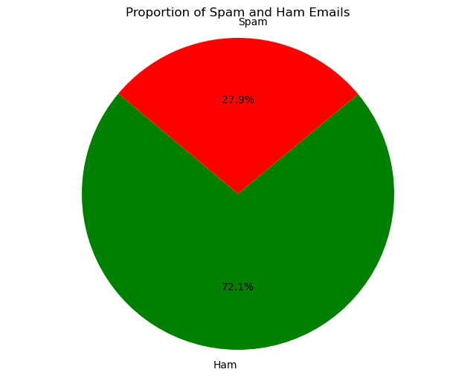
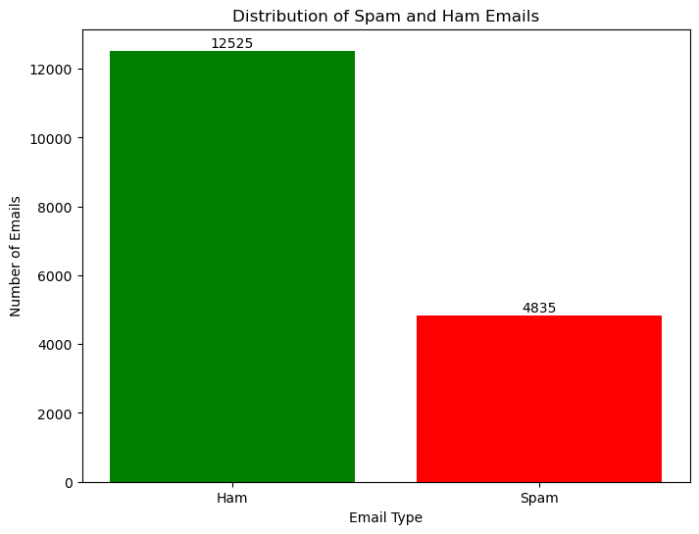
DATA VISUALIZATION POST-PROCESSING
It is evident that the distribution between spam and ham emails has completely reversed after data cleaning, indicating that the dataset was initially noisy, containing many rows with little meaningful information, consisting mainly of HTML tags or special characters.

Slide 9
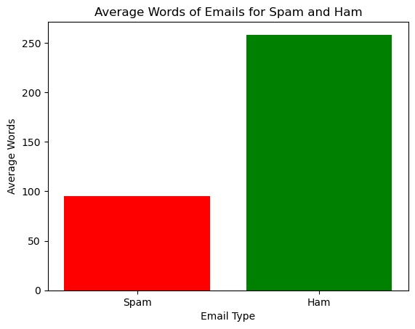
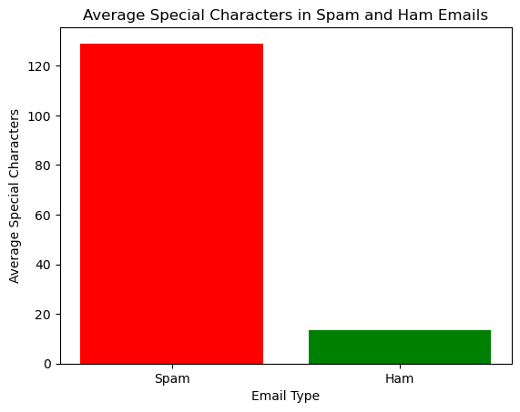
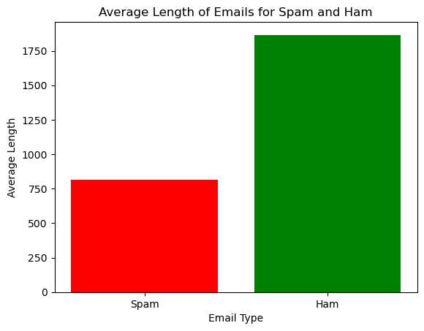
FEATURE SELECTION
Ham emails tend to be longer, often containing more detailed and formal content, such as signatures and introductions, while spam emails are typically shorter, designed to grab attention quickly with minimal text.
Spam emails contain significantly more special characters compared to ham emails, highlighting the use of symbols in spam to bypass filters and attract attention.

Slide 10
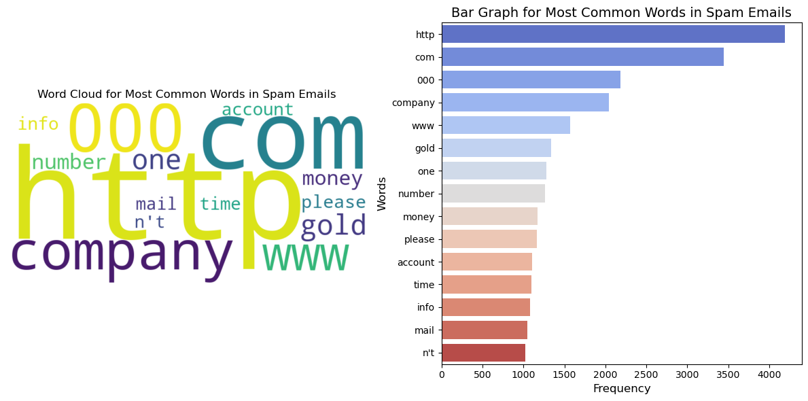
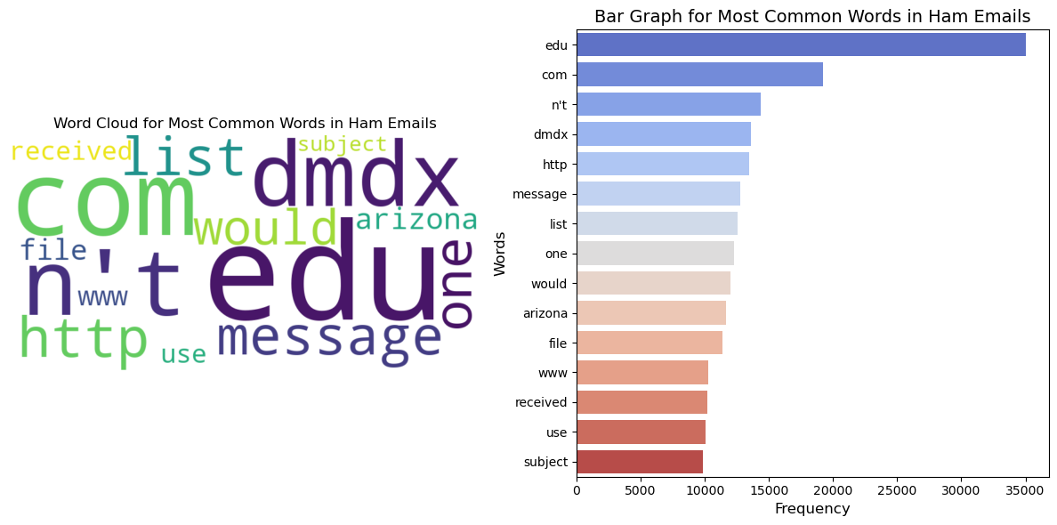
Most common words
I visualized the most common words using a word cloud and a bar chart to highlight the most frequent terms in the spam emails.
Spam tends to be more transactional,
with keywords promoting products, services,
or financial offers.
Ham tends to be more related to formal communication, such as educational or professional contexts, with less emphasis on promotional language.
Notes:
DMDX is a software developed in Arizona primarily used in cognitive psychology and neuroscience experiments for precise stimulus presentation and accurate reaction time measurement.

Slide 11
DATA PROCESSING
Word2Vec | TF-IDF
A neural network-based model that generates dense vector representations (embeddings) for words. | A frequency-based statistical method for representing text as sparse vectors.
Learns distributed representations by analyzing word context. | Calculates the importance of a word in a document relative to the entire corpus. Formula: TF-IDF=TF×IDF where: TF: Frequency of a word in a document. IDF: Penalizes common words (e.g., "the," "of").
Produces dense, fixed-size vectors Captures semantic similarity between words. | Produces sparse, high-dimensional vectors. Does not capture context or semantic relationships between words.
I applied the hold-out method splitting the dataset into 70% for training and 30% for testing using both TF-IDF and Word2Vec representations across four different models to compare their performance.

Slide 12

DATA PROCESSING
The same process was applied to each of the four models Random Forest, Logistic Regression, Decision Tree, SVC to evaluate their performance:
training the classifier on the training data
making predictions on the test set
calculating various performance metrics including accuracy, confusion matrix, precision, recall, F1 score, classification report, ROC curve, and AUC.

Slide 13
Performance Evaluation
W2VEC
Model | Accuracy | Precision | Recall | F1 Score | ROC AUC
SVM | 0.965246 | 0.940319 | 0.934483 | 0.937392 | 0.991262
Random Forest | 0.967166 | 0.961733 | 0.918621 | 0.939683 | 0.99405
Decision Tree | 0.941436 | 0.908637 | 0.877931 | 0.89302 | 0.921935
Logistic Regression | 0.957949 | 0.93071 | 0.917241 | 0.923932 | 0.988009
TF-IDF
Model | Accuracy | Precision | Recall | F1 Score | ROC AUC
SVM | 0.983487 | 0.969697 | 0.971034 | 0.970365 | 0.994893
Random Forest | 0.961406 | 0.971321 | 0.887586 | 0.927568 | 0.992777
Decision Tree | 0.936828 | 0.885754 | 0.887586 | 0.886669 | 0.921707
Logistic Regression | 0.976959 | 0.966339 | 0.950345 | 0.958275 | 0.994661

Slide 14

K-cross validation
Although the hold-out approach provides a quick evaluation of the model, it is sensitive to how the data is split, potentially leading to unreliable results; therefore, I decided to use k-fold cross-validation for these reason:
- Improved Reliability: it reduces the impact of data variability by averaging performance across all folds.
- Balanced Evaluation: using Stratified K-Fold, I ensure each fold maintains the same proportion of spam and ham emails, preserving the class distribution.

Slide 15

K-cross validation
For k=10 fold each model followed these steps:
Pipeline Creation: Emails were vectorized with TfidfVectorizer, and models were trained.
Cross-Validation: Used Stratified K-Fold to compute metrics (accuracy, precision, recall, f1-score) for each folds.
Performance Analysis: Averaged metrics to estimate generalization performance.

Slide 16
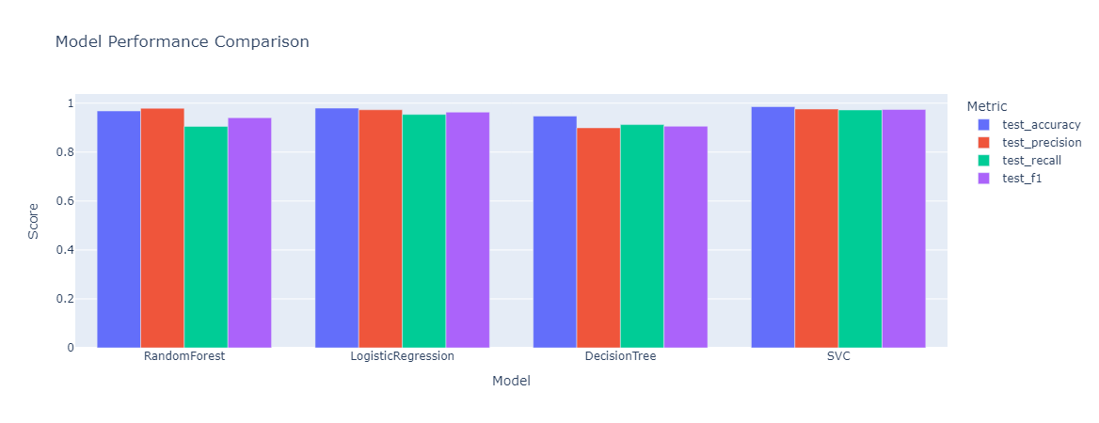
Averaged metrics obtainted using 10-cross validation
Model | Accuracy | Precision | Recall | F1 Score
SVM | 0.985657 | 0.976143 | 0.972285 | 0.974201
Random Forest | 0.968203 | 0.979226 | 0.905056 | 0.940626
Decision Tree | 0.947026 | 0.899233 | 0.912300 | 0.905666
Logistic Regression | 0.979781 | 0.973002 | 0.953873 | 0.963327

Slide 17
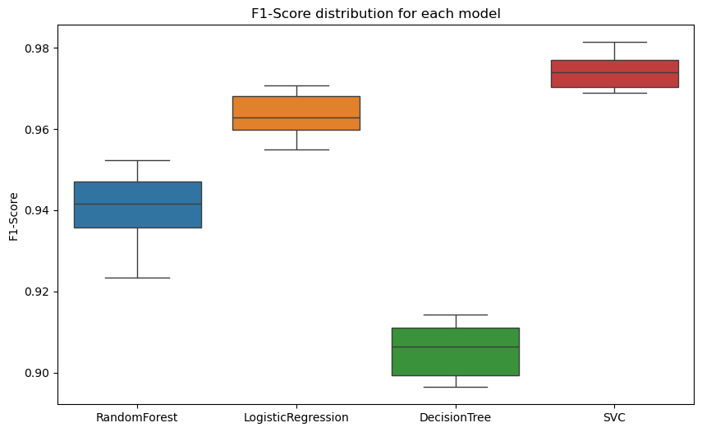
Validation
Statistical Comparison of Models
F1-Score Selection: Chosen for its balance of precision and recall, crucial for spam detection.
Wilcoxon Test: Used to assess significant differences in F1-scores across models; p-value < 0.05 indicates significance differences
Visualization: Boxplots illustrated F1-score variability across folds.
Error Rate Calculation: Error Rate was calculated as 1 − F1-score, where lower values indicate better performance.
Notes:
To evaluate and compare the performance of the models, I performed the following steps:
Selection of F1-Score as the Evaluation Metric: The F1-score was chosen as the primary evaluation metric because it provides a balanced measure that combines precision and recall. This metric is particularly suitable for spam detection tasks, where both false positives (ham emails misclassified as spam) and false negatives (spam emails misclassified as ham) can have significant implications.
Wilcoxon Test: To determine whether the observed differences in F1-scores across the models were statistically significant, I applied the Wilcoxon Test. A p-value less than 0.05 indicates significant differences, rejecting the null hypothesis. A p-value greater than or equal to 0.05 suggests no significant differences.
A boxplot was generated to visualize the F1-score distribution across all cross-validation folds for each model, providing a clear picture of their performance variability.
Error Rate Calculation: For each model, the Error Rate was calculated as 1−F1-score. This reflects how well each model performs, with a lower error rate indicating better performance.

Slide 18
Wilcoxon Test Results
 | Random-Forest | Logistic Regression | Decision Tree | SVC
Random-Forest | - | 0.001953 | 0.001953 | 0.001953
Logistic Regression | 0.001953 | - | 0.001953 | 0.001953
Decision Tree | 0.001953 | 0.001953 | - | 0.001953
SVC | 0.001953 | 0.001953 | 0.001953 | -
Since all p-values from the Wilcoxon tests are below 0.05, I can reject the null hypothesis and conclude that the differences in performance between the models are statistically significant.
Based on the error rate calculations, it is evident that SVC is the best classifier, as it has the lowest error rate among the models.
Model | Error Rate
Random-Forest | 0.059
Logistic Regression | 0.037
Decision Tree | 0.094
SVC | 0.026

Slide 19
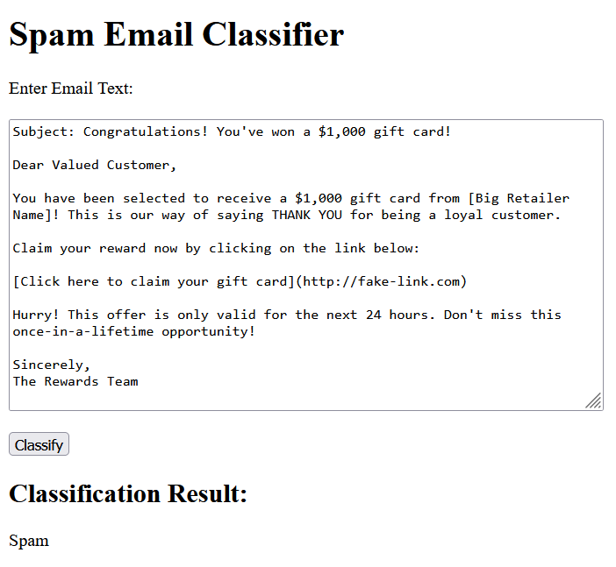
Real Time Classifier
.
The SVC model trained is saved using joblib. This allows the model to be used in real-time without needing to retrain it every time.
Flask is used to create a web application. The app has an endpoint / where users can access a form to enter an email for classification.
When the app starts, it loads the saved model and the TfidfVectorizer used for feature extraction.
The /classify endpoint receives a POST request with an email's content, applies the same feature extraction using TfidfVectorizer, and then classifies the email using the loaded SVC model.
The result is returned as either "Spam" or "Ham" based on the classification.

Slide 20
Proposal for Improvements
1. Hybrid Feature Representation: Combine Word2Vec and TF-IDF to leverage semantic richness and frequency-based insights.
2. Incorporating Deep Learning Models: Investigate transformer-based models like BERT for email spam detection
3. Data Augmentation: Enhance the dataset with additional spam and ham emails to improve training.
4. Handling Imbalanced Data: Implement advanced techniques like SMOTE for better handling of class imbalances.

Slide 21
References
The references I consulted have been a valuable guide throughout this research. They provided essential insights into the models and techniques used, allowing me to understand the underlying methodologies in depth. Furthermore, they served as a benchmark for comparing my results with those reported in the literature, helping me assess whether my findings were consistent with or deviated from existing studies.
1. Classification of Phishing Email Using Word Embedding and Machine Learning Techniques - https://www.researchgate.net/publication/360456225_Classification_of_Phishing_Email_Using_Word_Embedding_and_Machine_Learning_Techniques
2. Spam Email Detection Using Deep Learning Techniques - https://www.sciencedirect.com/science/article/pii/S1877050921007493
3. Comparative Analysis of Machine Learning Algorithms for Email Phishing Detection Using TF-IDF, Word2Vec, and BERT https://www.sciencedirect.com/org/science/article/pii/S1546221824008117
4. Comparative Analysis of Machine Learning and Deep Learning for Email Spam Detection - https://www.techrxiv.org/users/802623/articles/1187484-comparative-analysis-of-machine-learning-and-deep-learning-for-email-spam-detection
Although some of the references focus on phishing email detection, their methodologies and findings provide significant insights into spam email detection due to shared characteristics in text processing, feature extraction, and classification.

Slide 22

Thank you for your attention!

